Slide 1
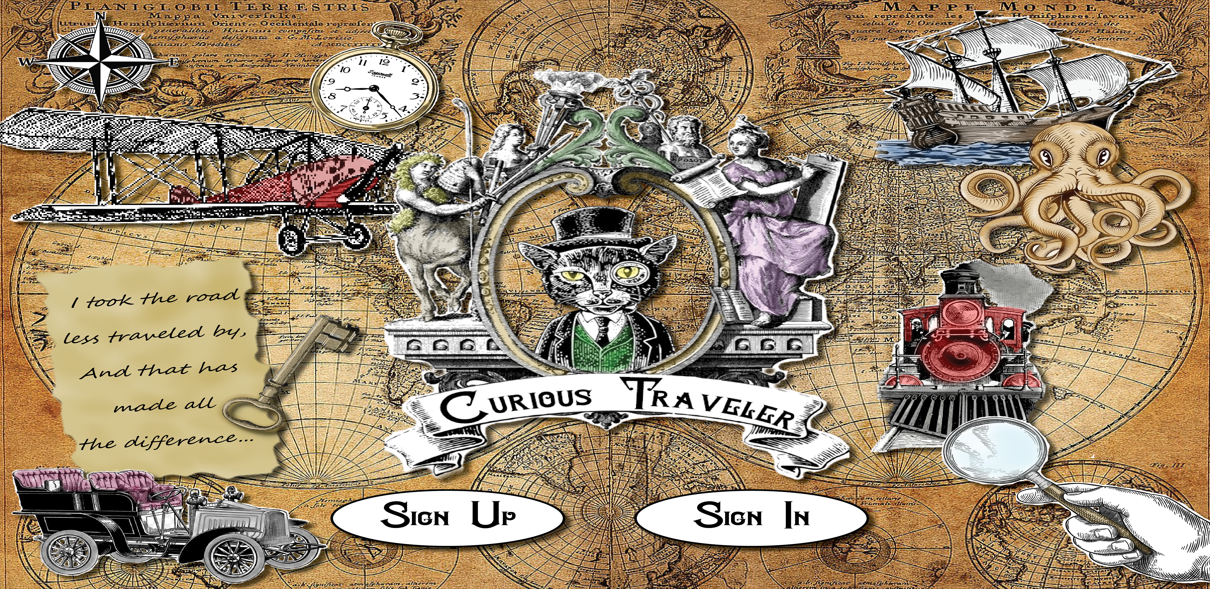

Slide 2
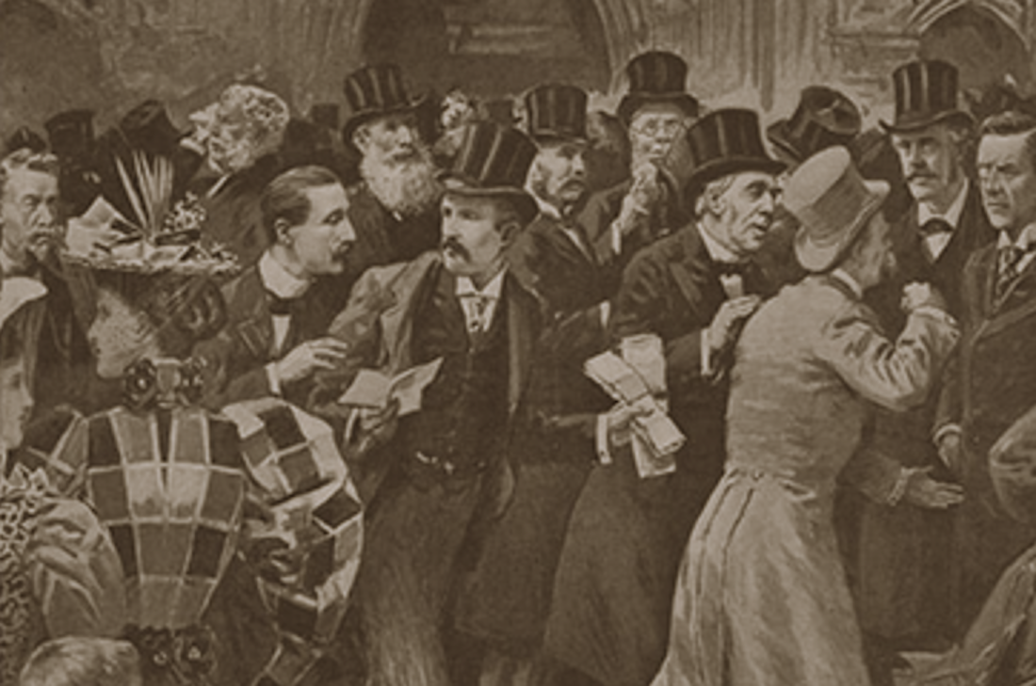
Feeling a bit crowded?
Tired of spending hours, days or weeks planning your trip or vacation only to be disappointed by large crowds getting in the way? Or maybe you're sick of the same old, same old. Why not try something new?
We have created an app to address all of these issues.

Slide 3
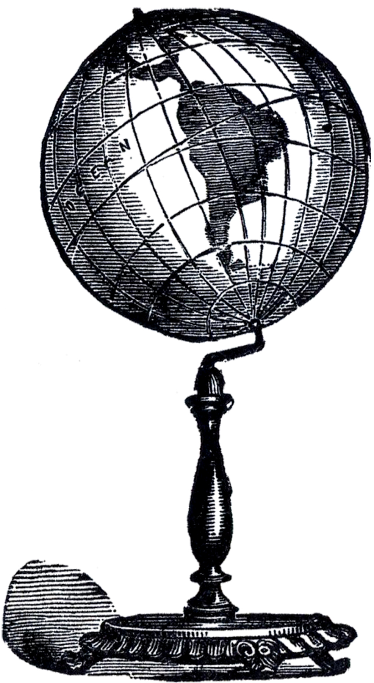
Concept
Curious Traveler is an app designed to share unique or obscure destinations.
We were motivated to develop this app because we want to share our favorite finds and discover new ones.
As someone who enjoys traveling and trying new things I want to post/view travel destinations, unique businesses and more so that I can experience something different.

Slide 4



Process
Technologies used: JavaScript, HTML, CSS, mysql, sequelize, node
Task Breakdown:
Tammy: Project Structure/Scaffolding, Password Hashing, Database & Table creation, Debugging, Other
Cheri: Seed files, Handlebars, Slideshow, Stylesheet, Other
Shybreasia: Handlebars, Stylesheet, Debugging, Other
Challenges: Github Issues, Trouble getting the login to work
Successes: We have an MVP with the basic functionality and design

Slide 5
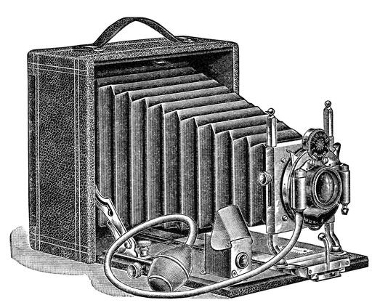
Future Development
Ability to add Photos
Ability to Search for destinations by City/State
Ability to react to posts
Polish the UI
Make Mobile Responsive

Slide 6
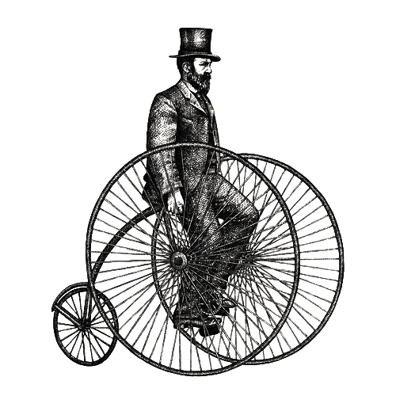
Links/Demo
GitHub Repo:
https://github.com/cmerrym1/curious-traveler/tree/feature/style
Heroku: https://blooming-ridge-28074.herokuapp.com/

